Slide 1
Aspects of Human Growth & Development
Dr. Imran A. Sajid
Disclaimer: A significant part of these slides is based on the works of ChanchadII on Slideshare at https://www.slideshare.net/Chanchad11/introduction-to-human-growth-development

Slide 2
ASPECTS OF DEVELOPMENT
Physical Development
Intellectual
Personality and Social
Moral
Spiritual

Slide 3
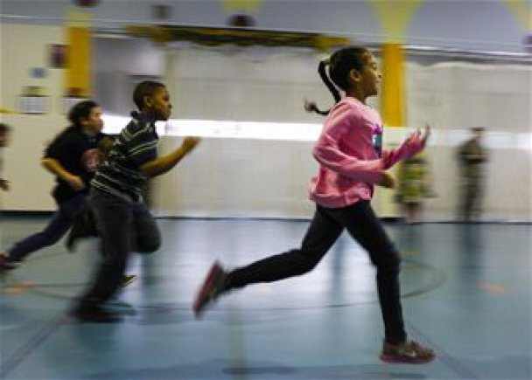
1. Physical Development
Changes in the body, brain, sensory capacities, and motor skills which exert a major influence on both intellect and personality.
e.g. an infant’s knowledge of the world comes from the senses and from motor activity
while a person in late adulthood has physical changes in the brain, as in Alzheimer’s disease, can result to loss in memory for recent events and in personality deterioration.
Physical development involves growth and changes in the body and brain, the senses, motor skills, and health and wellness.

Slide 4
2. Cognitive/Intellectual Development
Changes in a wide variety of mental abilities such as learning, memory, reasoning, thinking, and facility with language.
These changes are closely related to both the motor and the emotional aspects of development.
Cognitive development involves learning, attention, memory, language, thinking, reasoning, and creativity.

Slide 5
3. Psychosocial Development
Infancy and Childhood →temperament and attachment
Adolescence and Adulthood →
social world expands,
child grows psychologically,
different types of play and interactions with other children and teachers
Peers become more important,
exploring new roles and forming their own identities.
Dating, romance, cohabitation, marriage, having children, and finding work or a career
Psychosocial development involves emotions, personality, self-esteem, and relationships

Slide 6
4. Moral Development
This is to become gradually aware of the distinction between right or wrong; to unfold standards or habits that have to do with right or wrong in conduct.

Slide 7
5. Spiritual Development
This is an evolution and refinement of thought and feeling; of the spirit or soul as distinguished from the body or material matters.
A consciousness of religion or the church that is held a sacred.
There are many aspects of spiritual development:

Slide 8
Beliefs -The development of personal beliefs, including religious beliefs; an appreciation that people have individual and shared beliefs on which they base their lives; a developing understanding of how beliefs contribute to personal identity.
A sense of awe, wonder and mystery - Being inspired by the natural world, mystery, or human achievement. Experiencing feelings of transcendence - Feelings which may give rise to belief in the existence of a divine being.
Search for meaning and purpose - Asking "why me?" at times of hardship or suffering; reflecting on the origins and purpose of life; responding to challenging experiences of life such as beauty, suffering and death.
Self-knowledge - An awareness of oneself in terms of thoughts, feelings, emotions, responsibilities and experiences; a growing understanding and acceptance of individual identity; the development of self-respect.

Slide 9
Relationships - Recognizing and valuing the worth of each individual; developing a sense of community; the ability to build up relationships with others.
Creativity - Expressing innermost thoughts and feelings through, for example, art, music, literature and crafts.
Feelings and emotions - The sense of being moved by beauty or kindness; hurt by injustice or aggression; a growing awareness of when it is important to control emotions and feelings, and how to learn to use such feelings as a source of growth.

